Slide 1
Massachusetts Probation Services Guide for Youth and Families for Violations of Probation
Jessica Sofio
Suffolk University Law School J.D. Candidate, 2020
jsofio@su.Suffolk.edu

Slide 2
Partnership
Mindy Schiedler
Juvenile Detention Alternatives Initiative Coordinator(JDAI)
Massachusetts Probation Service
“As the Massachusetts Probation Service JDAI Coordinator I promote and advocate for juvenile detention system reform within probation. JDAI Massachusetts is a state-wide initiative with County Committees in six counties, and with seven state-wide committees with a goal of bringing JDAI to the entire state. I am the primary support to probation to implement JDAI statewide. I serve as a liaison between the County Committees, the JDAI Governance Committee, and the State Coordinator(DYS), sharing information, addressing questions, and reporting progress both within and outside the court and probation systems. I participate in state-wide committees, attending and facilitating meetings, providing guidance and information regarding JDAI strategies and detention best-practices, and developing state-wide responses and action plans to achieve the goals of JDAI. I also serve as a formal training resource to the Probation Training Academy.” - Mindy Schiedler

Slide 3
Relevant Users
The relevant users for this project will include children in the juvenile court system, as well as their families. As defined under Mass. General Laws c.119 § 21:
“Child”, a person under the age of 18.
“Parent”, a mother or father, unless another relative has been designated as a parent as defined in section 1 of chapter 118 for the purposes of receiving benefits from the department of transitional assistance.
“Relative”, the father or mother of a child; a stepfather, stepmother, stepbrother, stepsister, or any blood relative of a child, including those of the half blood, except cousins who are more distantly related than first cousins; any adoptive relative of equal propinquity to the foregoing; or a spouse of any such persons.
“Young adult”, a person between the ages of 18 and 22.

Slide 4
Lack of Resources for Children and Families
Currently, children and families do not have resources to navigate the court process, including violations of probation.
Varies from court to court.
Probation will redirect certain questions and will instruct children and/or their families to speak to their attorney.
The Youth Advocacy Division (YAD) has a practice guide, but it is mainly for attorney usage.
Most attorneys are not probation experts, they focus on the law and rights.
Probation often does not advertise their internal process and system.

Slide 5
Anticipated Questions
Why should we care? These children are committing offenses against the commonwealth.
Access to justice. Change starts here.
Why can’t these children and their families just ask their attorney to explain the process?
Attorneys are not probation experts. Time constraints. Accessibility.
Why would an interactive tool be more useful than a printed hard copy?
In some cases, it might not be. Hopefully for most, it will be an incentive to learn.
How will you educate users without using length legal terms and definitions?
We will use common terms from court to avoid confusion, but will simplify when possible. Also, we will provide links to resources for users who want to “learn more” when asked.

Slide 6
Solution
Due to the group of users that we are targeting, we hope to develop a tool through QnA Markup that is:
Family-friendly, colorful, and approachable
Easy to read and understand (no overwhelming and confusing legal terms)
Interactive
Accessible to all through hyperlink, QR code, and hard copy printed versions
A note on *IEPS and juvenile delinquency (stretch goal)

Slide 7
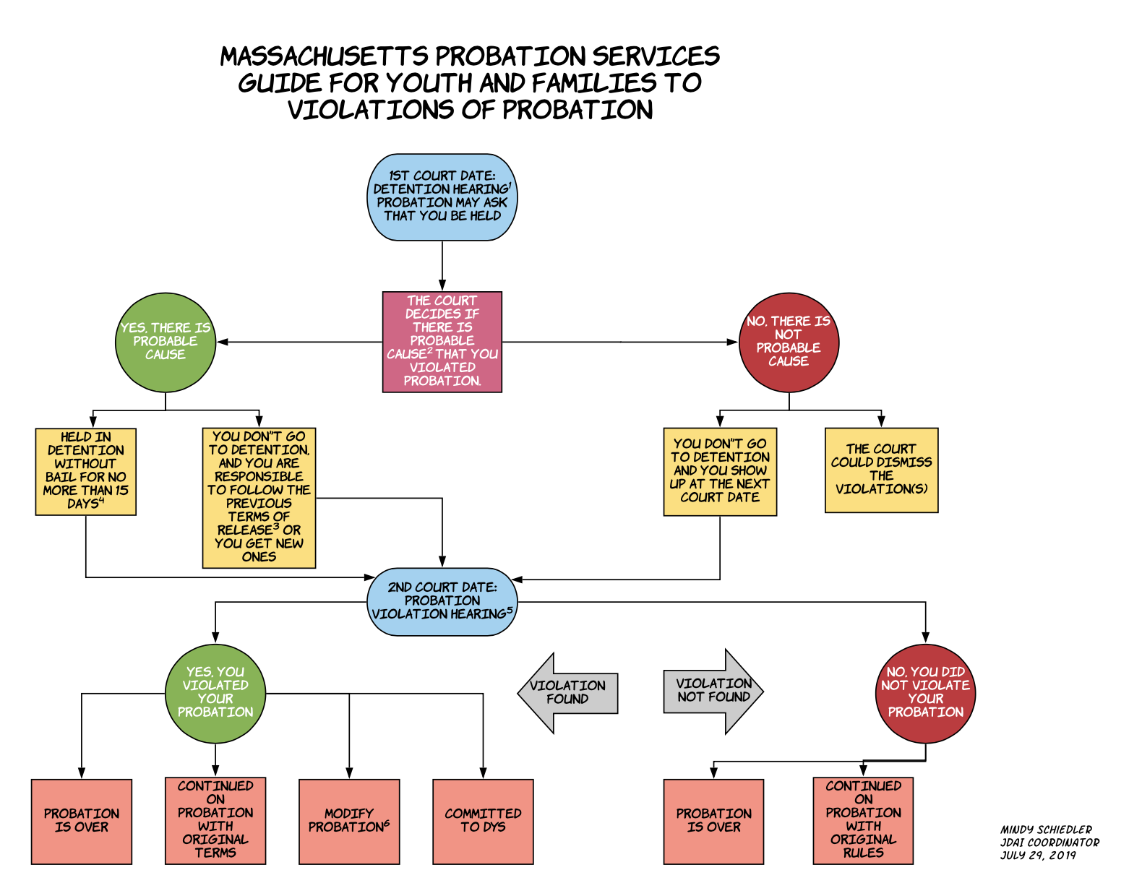
Flowchart
Mindy Schiedler has created a flowchart which has been reviewed and approved by all necessary personnel.
Do not anticipate any changes at this point.
https://drive.google.com/file/d/1-wK1igj_q7HAjG3Yv_PpqXDDfmKYZZRy/view?usp=sharing

Slide 8
User Feedback
Our goal is to have a workable version for young people to test by the first week of December.
The ideal tester would be a juvenile on probation, however, it is difficult to get a large sample in a room with the necessary technology and with permission of probation. We are hoping to have at least a small sample size of the exact demographic we intend to serve.
Additionally, Mindy is looking to coordinate an event where parents may access the program to see if it is helpful and user friendly.
Other non-court involved young people may also give useful feedback in regard to clarity of content, level of engagement, and easiness of use.

Slide 9
Thank you for your time!
Please feel free to share any feedback or thoughts.

